Slide 1
Building and Supporting
Inclusive Gifted Programs
UConn, May 2024
Dina Brulles, PhD

Slide 3
My Message Today
Centered on equity and inclusiveness in gifted programming
Focused on students, gifted programming, identification & placements, and staff collaboration
Constructed for you to take to your school stakeholders: parents, teachers, school administrators, school board members
Notes:
You

Slide 4
A JEDI Conversation
On Gifted Programming

Slide 5
“JEDI” RELATED TO GIFTED ED.
J
JUSTICE
E
EQUITY
DIVERSITY
D
I
INCLUSION

Slide 6
“JEDI” RELATED TO GIFTED ED.
Justice: explicitly creating procedures that ensure that gifted programs are equitable, inclusive, and honor diversity in schools.
Equity: evaluates and identifies strategies for minimizing underrepresentation & creates protocols for ID and serving underserved populations.
Diversity: inclusivity in gifted services, which relies on equitable ID & programming.
Inclusion: invitation to contribute to procedures that invite and honor diversity in order to create welcoming and valued participation in gifted services.

Slide 7
Equity responds:
Who wants/needs to be included in our gifted programs, but cannot?
Whose ability is not even recognized for admittance in our gifted programs?
Diversity asks:
Who is included in our gifted programs?

Slide 8
Equity responds:
Diversity asks:
What conditions have we created that maintain certain groups as the de facto majority here?
How many additional students of color do we have this year than last?

Slide 9
Justice challenges:
Whose well being is sacrificed and minimized to allow others to be comfortable maintaining
these views?
Inclusion asks:
Is this environment safe for everyone to feel they belong?

Slide 10
Equity responds:
What are people experiencing that isolates them and makes them feel separated from others who are intellectual peers?
Diversity asks:
Is it not exclusionary to provide funding for safe spaces and then separate students?

Slide 11
AS LEADERS AND ADVOCATES:
Consider:
How can you contribute to the process?
Who can you impact at the school or district level?
How can you advocate for change in the schools?
Notes:
You

Slide 12
AT THE SCHOOL/DISTRICT LEVEL
Focus on:
Developing inclusivity through equitable ID
Integrating gifted students’ needs into all aspects of school
Building, supporting & maintaining inclusive practices
Notes:
You

Slide 13
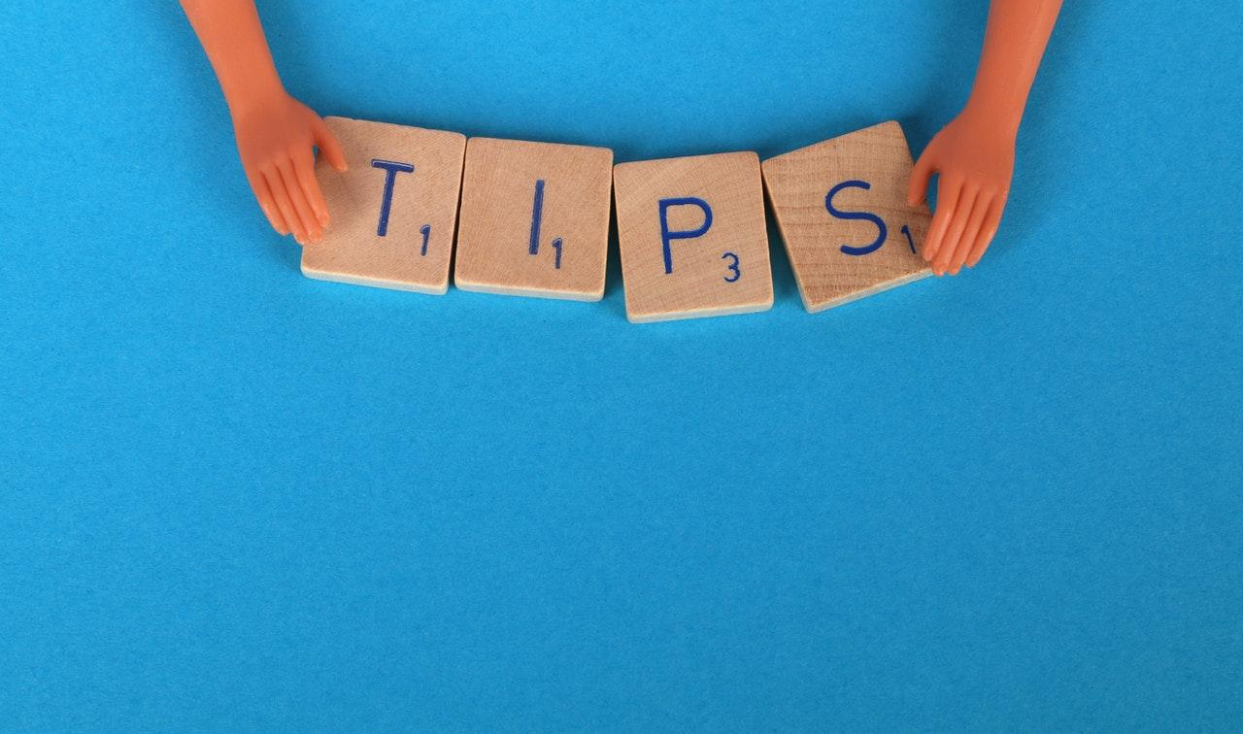
TOP 3
Embed G/T services into existing school structures
Encourage district level collaboration to strengthen services
Share strategies for building sustainable gifted services
Notes:
You

Slide 14
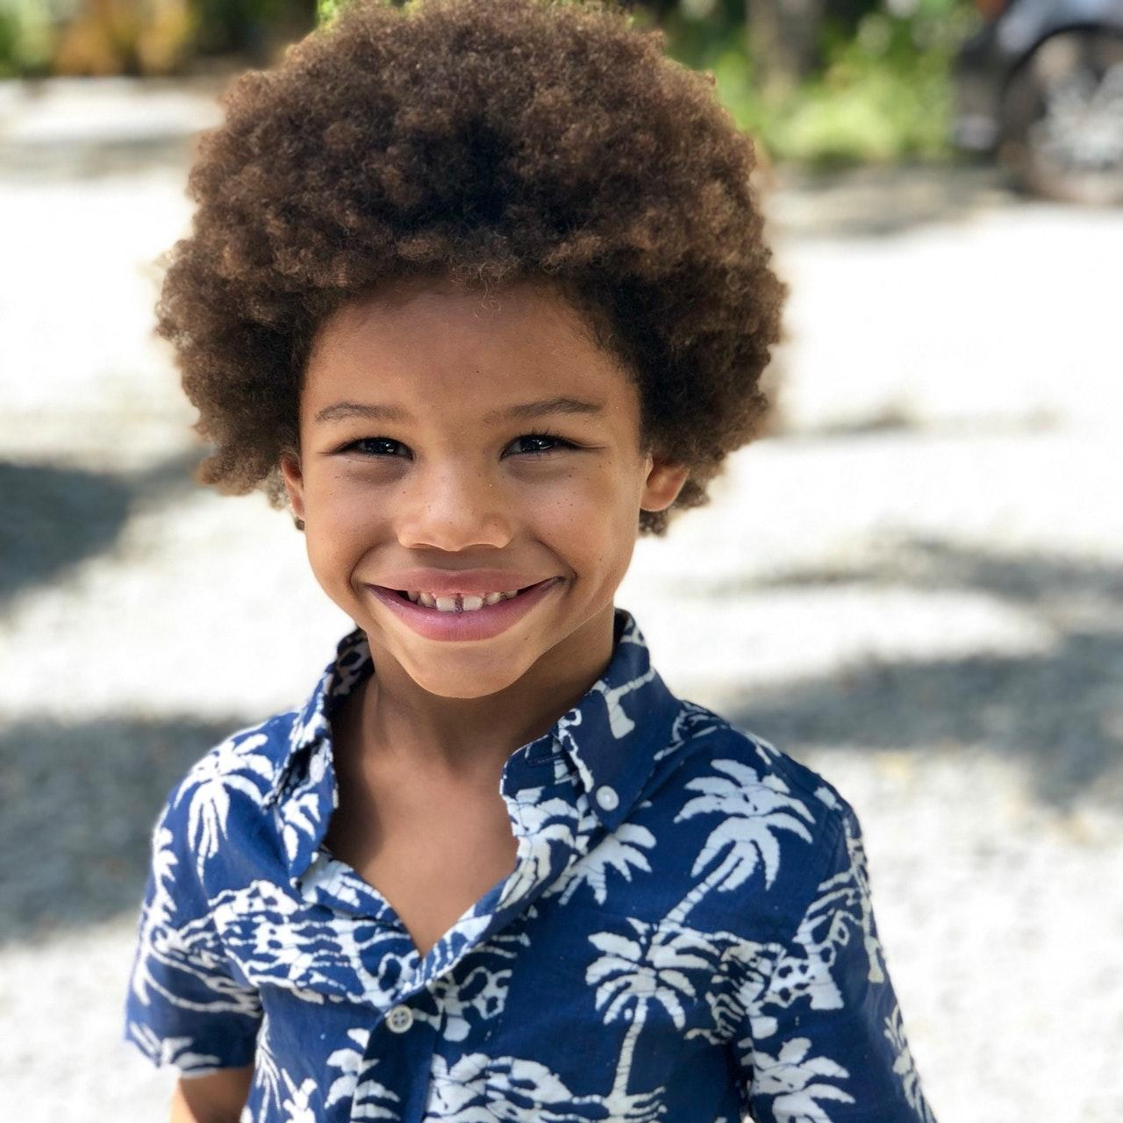
Do all our students believe that...
Schools have their best interests at heart?
Getting a good education will benefit everyone in the same way?
They can each pursue educational goals with the same outcomes in mind?
Notes:
Students

Slide 15
Be Welcoming and Empowering
Create spaces where students feel welcome and empowered to contribute to a community.
Recognize that some feel like outsiders in gifted programs and many struggle to develop a sense of belonging.
Notes:
Programming

Slide 16
Considering Identity
Who am I?
To what groups do I belong?
How do others see me?
Notes:
Students

Slide 17
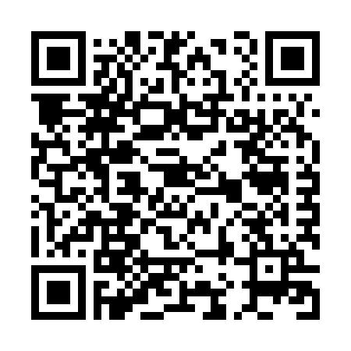
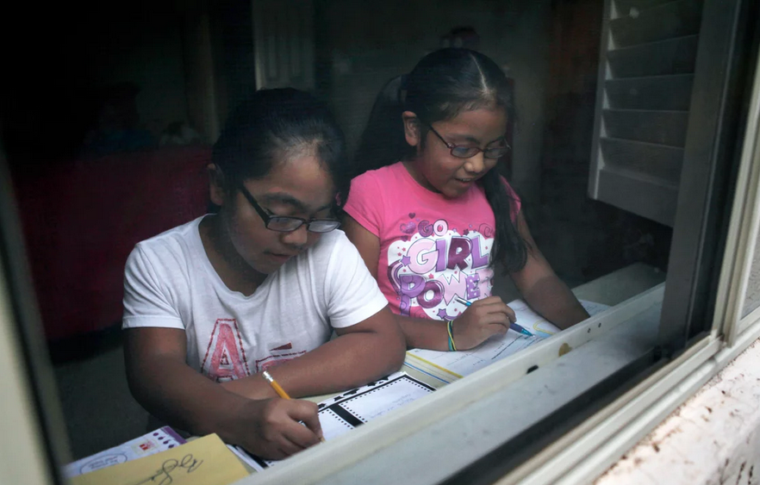
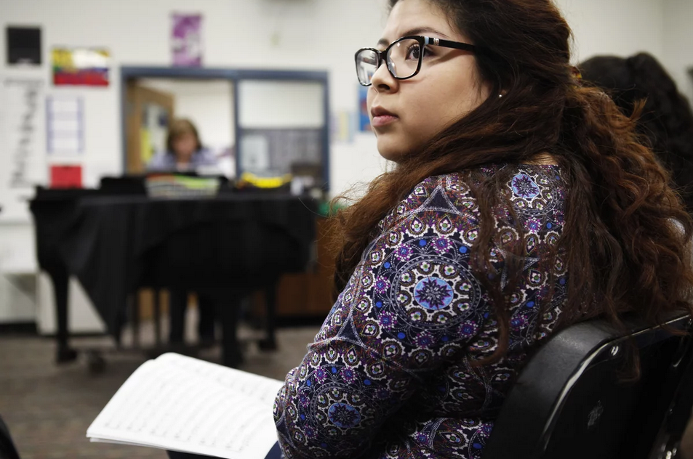
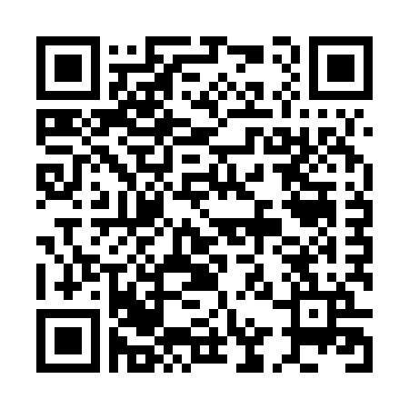
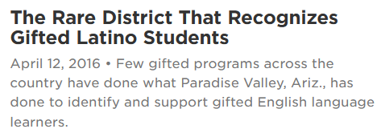
Meet Vanessa Minero Leon and Alejandra Galindo, gifted ELL students in PVSchools featured on NPR.
https://goo.gl/o3YsRr
https://goo.gl/uf2oKb
https://goo.gl/6t0VwT
Notes:
Students
NPR links / QR codes - Talk about these two students

Slide 18
The Gifted Programming Dilemma:
The Chicken or the Egg?
Notes:
Programming

Slide 19
Provide tips for creating equitable gifted services:
First identify students with high potential regardless of achievement levels or language proficiency.
Then develop your services in response to their needs.
And then identify the training and curriculum needed to prepare teachers to teach in your model(s).
Notes:
Programming
Then create an ongoing system for supporting new and continuing teachers.

Slide 20
4 Prevalent Program Models for serving gifted students
Examined through an equity lens
Cluster Grouping
Enrichment Classes
Honors Classes
Self-Contained Programs
Notes:
Programming

Slide 21
Solutions for Equitable ID & Services
Using local norms
Obtain scores for ALL students in the grades for which placement decisions are made
Decide how the information obtained for each student is used and (if) weighted

Slide 22
Multiple Measures & Multiple Pathways!
Different needs and circumstances require different approaches to testing and identification
Ex. – Universal testing and “flexing in” at Title I schools
Notes:
Programming
Describe process using local norms. 90 – 96% flexed depending on school.
Flex letters yearly
Not officially identified as gifted but on the gifted teachers’ rosters. Gifted teacher is teacher of record for math and reading.

Slide 23
Developing A Continuum of Services:
Why?
Builds inclusivity
Provides ongoing entry points
Recognizes strengths
Responds to students’ learning levels
Works at district, building and classroom levels
It’s the right thing to do!
Notes:
Dina

Slide 24
Developing A Continuum of Services:
How?
At 3 levels:
District - ex., leveled and variable services
School building - ex., clustering, achievement levels
Classroom - ex., flexible grouping
Notes:
Dina

Slide 26
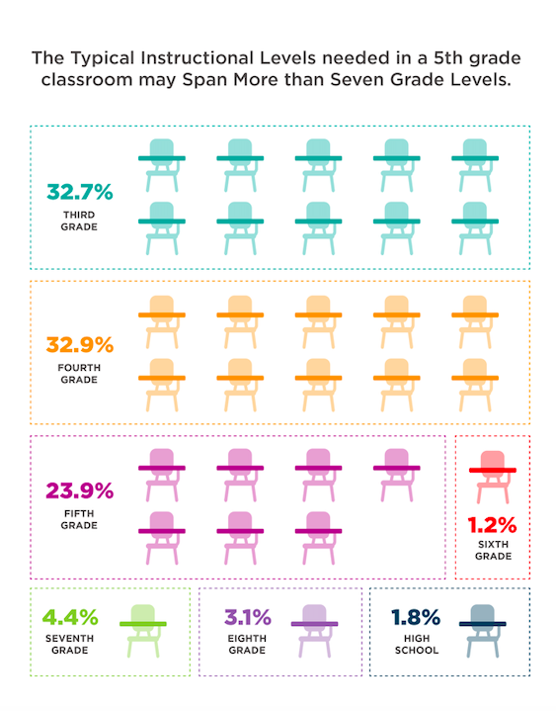
Notes:
Dina

Slide 27
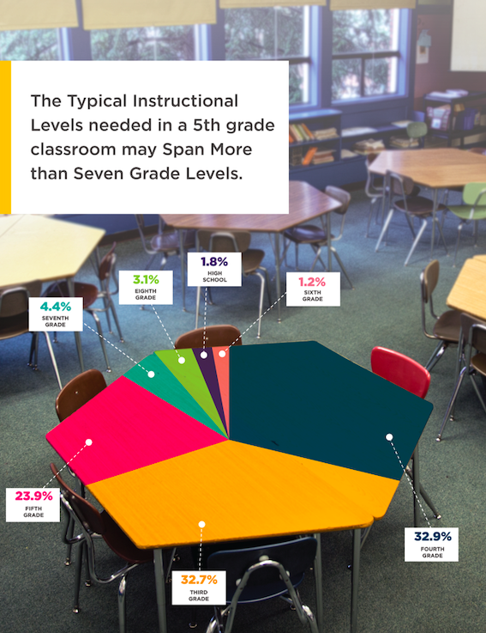
Notes:
Dina

Slide 28
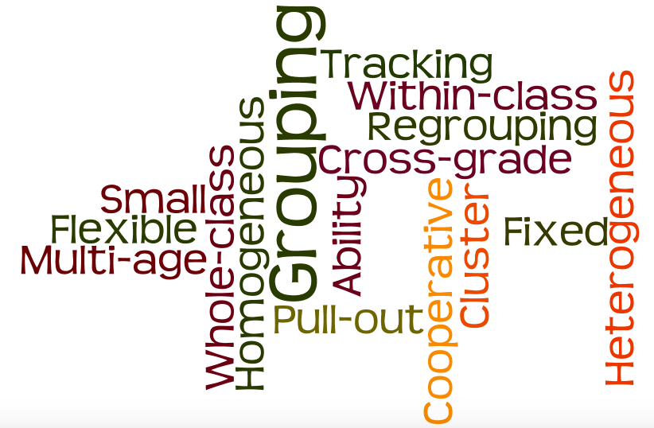
Grouping Practices
Notes:
Dina

Slide 29
Dispelling the Myths about Grouping Practices
#1: Groupings are usually permanent.
#2: All grouping methods are tracking
#3: Groupings are based only on achievement levels
#4: Groupings only benefit high-ability and high-achieving students
#5: Grouping students eliminates the need to differentiate instruction
#6: Grouping discriminates against minority populations
Notes:
Dina

Slide 30
DEVELOPING FLEXIBLE GROUP FRAMEWORKS
Ability-based - students grouped with like abilities
Interest-based - aligned to foster and develop student interests
Performance - based - placement based on pre-assessment data
Readiness - based - readiness to address content
Preference - based - preferred learning modalities
Objective - based - specific learning objectives
Notes:
Dina

Slide 31
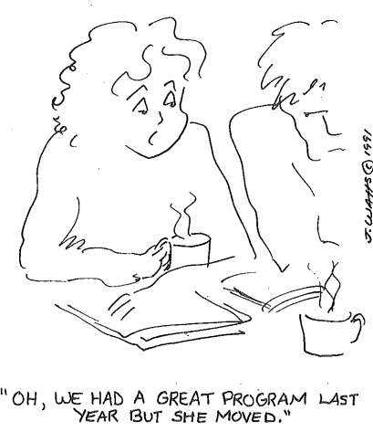
Build Sustainable Services

Slide 32
BUILDING SUSTAINABLE SERVICES
People change jobs. Systems stay in place longer.
Embed gifted services into school structures and initiatives
Collaboration Among Administrators:
- Creates common practices and produces shared expectations
Build collaboration with other departments
- Language Acquisition, Special Education, Professional Development Curriculum, Grants, Assessment, Fine Arts
Notes:
Programming
Make friends, collaborate, integrate what you want for your gifted students into existing systems and structures.

Slide 33
BUILDING SUSTAINABLE SERVICES
Build stakeholder support, including parents, school staff and district administrators
Provide information to all groups: teachers’ union, district level admin, student services, principals, staff, parents,… anyone and everyone!
Fine tune your message for these different groups
Notes:
Programming
Thru building stakeholder support PLUS district administration buy-in you can emphasize support for CLD and Underrepresented pops. This helps build longterm, sustainable services to ALL gifted students.

Slide 34
ADVOCATE FOR EQUITY IN ALL THAT YOU DO!
Collect and share identification and achievement data to emphasize the need to change course on the school’s methods for providing gifted services.

Slide 35
SHOWING GROWTH IN GIFTED
Measure and record:
Ethnic representation of gifted students
Academic achievement of gifted students
Gifted population identified and served by year
Professional development for teachers
* Provide data to principals and district admin.
Notes:
Advocating for gifted services requires relying on data (as well as stories).
I share data with district administrators. This has GREAT impact!

Slide 36
Integrate your efforts into every department!
Build connections with those who oversee or work with assessment, language acquisition, professional development, curriculum, special education and grants.
Building relationships with departments provides continual opportunities to embed awareness of G/T students’ learning needs into the school system’s infrastructure.

Slide 37
Tips and Cautions From a School Administrator
Tips:
Speak softly and carry a big stick
Begin by sharing information.
Arm yourself with information, facts, data, and legislation.
Present concise and focused evidence.
Caution:
Recognize that school staff are exhausted.
Consciously build into; not asking for more, rather, “how to”.

Slide 38
Effective Collaboration
In the Schools
Notes:
Collaboration

Slide 39
Remember
Supporting gifted education does not require additional funding, but rather collaboration within the district and allocating existing resources to fulfill our school’s mandate to support and challenge all our students, including the gifted.

Slide 40
Dept. / Admin. Collaboration
Assistant Superintendent
Language Acquisition Dir.
Human Resources Director
Assessment Director
Curriculum Director
PD Director
Student Services Director
Title I Coordinator
Community Education
SpEd Director

Slide 41
ASSISTANT SUPERINTENDENT
To establish the need for a systemic schedule of gifted services
Implementing district-wide gifted programming adoptions
Obtaining Governing Board approval for district gifted plan
Supporting Parent Group Partnerships
Building Principal support
Notes:
Collaboration

Slide 42
LANGUAGE ACQUISITION DIRECTOR
To inform ELL teachers and language acquisition testers on:
Characteristics of CLD gifted learners
Culturally responsive teaching
Notes:
Collaboration

Slide 43
SPECIAL EDUCATION DIRECTOR
To inform: School Psychologists and Special Ed. Teachers
Characteristics of gifted learners
Identifying 2e student
Teaching 2e students
Notes:
Collaboration

Slide 44
To organize staffing to maximize gifted services when adjusting to:
Gifted program modifications
Fluctuations in gifted student enrollment
Teaching expectations
HUMAN RESOURCES DIRECTOR
Notes:
Collaboration

Slide 45
To review, track and chart student achievement data by:
School, grade level, ethnicity, Title 1 schools, etc.
Data strengthens and supports advocacy efforts!
ASSESSMENT DIRECTOR
Notes:
Collaboration

Slide 46
To align curriculum and instruction to meet gifted students’ learning needs.
Involves:
Pacing guides
Out-of-level curriculum
Emphasis on critical thinking and creativity
CURRICULUM DIRECTOR
Notes:
Collaboration

Slide 47
PD COORDINATOR
To provide specific professional learning opportunities and support for teachers of gifted students.
Involves:
Inservices, workshops, conferences, etc.
Addressing nature & needs of the gifted and effective instruction for high ability learners
Notes:
Collaboration

Slide 48
STUDENT SERVICES DIRECTOR
To collaborate when students have issues related to anxiety, perfectionism, radical acceleration, intensities, behavior, 2e, and absenteeism.
Provide information on appropriate accommodations for gifted students with 504 plans
Notes:
Collaboration

Slide 49
TITLE I COORDINATOR
To examine and record gifted student demographics.
Useful for:
Advocating for equity
Funding decisions
Embedding gifted education into school structures
Notes:
Collaboration

Slide 50
COMMUNITY EDUCATION DEPARTMENT
To develop enrichment classes designed toward gifted learners in afterschool and summer school programs.
Consider creating a gifted preschool to complement the other PSs offered

Slide 51
When Speaking w/ Admin ask Q’s like…
What do our gifted students need from the new science (math, reading, etc.) adoption?
How should I prepare my gifted students for grade level state assessment when they are subject area accelerated?
Can we support gifted cluster teachers in obtaining a gifted endorsement?
This draws attention to, and builds awareness of, gifted students’ needs within standard school structures.

Slide 52
Dina Brulles
dbrulles@gmail.com
www.giftededucationconsultants.com

